Slide 1
Chapter 1 The Particulate Nature of Matter
Wilt Gu

Slide 2
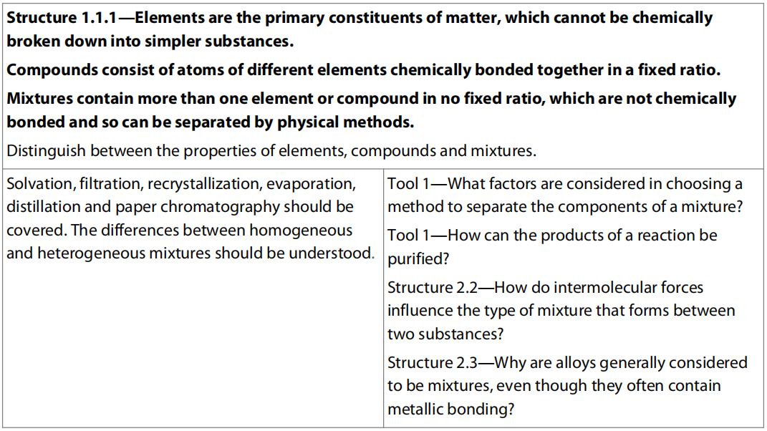
1.1 Elements, Compounds, and Mixtures

Slide 3
Chemical Elements And their Symbols

Slide 4
Characteristics of Matter
Makes up of atoms, molecules, or ions.
Particles are in constant motion.
Occupies a volume in space.
Has a mass.

Slide 5
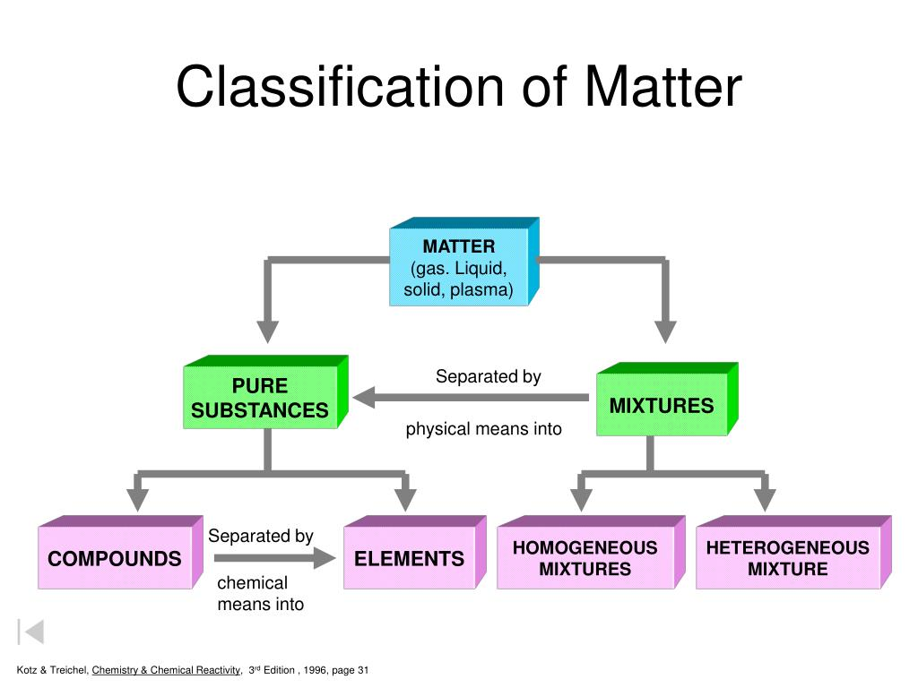

Slide 6
Pure Substance & Mixture
Pure Substance: Substance that is composed of only one kind of substance that cannot be divided by physical means.
Mixture: Substance that is composed of two or more pure substances in which no chemical combination has occurred. The mass ratio of different pure substances can be changed by adding or removing one or more of its component substance(s).

Slide 7
Elements & Compounds
Element (elementary substance): Pure substance that is formed by only one chemical element.
Compound: Pure substance that is formed by more than one chemical element.

Slide 8
Homogeneous & Heterogeneous Mixture
Homogeneous mixture: A mixture that has uniform composition and properties throughout. It is always a solution but can be in different states. E.g.: a solution of salt in water; a metal alloy such as bronze; air.
Heterogeneous mixture: A mixture that has non-uniform composition so its properties are not the same throughout. E.g.: water and oil.
It is usually possible to see the separate components in a heterogeneous mixture but not in a homogeneous mixture.

Slide 9
How do we know if a substance is pure?
Pure substances melt (and boil) at a temperature that is always the same for a particular substance.
Pure water always boils at 100 ºC. (at 1oo kPa) whereas pure alcohol (ethanol) always boils at 78ºC (at 1oo kPa).
If there is an impurity in a liquid, its boiling point is raised slightly and its freezing point is lowered and neither of the points is sharp.
So salty water will freeze over a range of temperatures a little below 0ºC and it will boil over a range of temperatures just above 100ºC.

Slide 10
Melting point determination
A Thiele tube can be used in the melting point determination.
The capillary tube containing the sample is attached to a thermometer and put into an oil bath.
The oil bath is then heated, slowing down the heating rate as the expected melting point is approached.
Two temperatures are recorded: first, when the tiny yet visible droplets appear, and second, when the entire sample has just melted.
Electronic melting point apparatus may contain a built-in magnifying glass that facilitates observation of the sample.

Slide 11
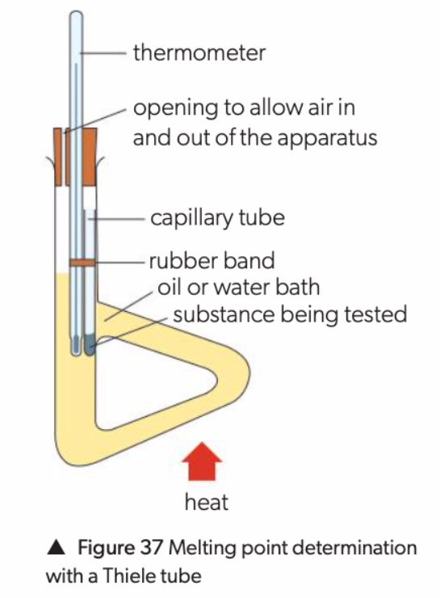

Slide 12
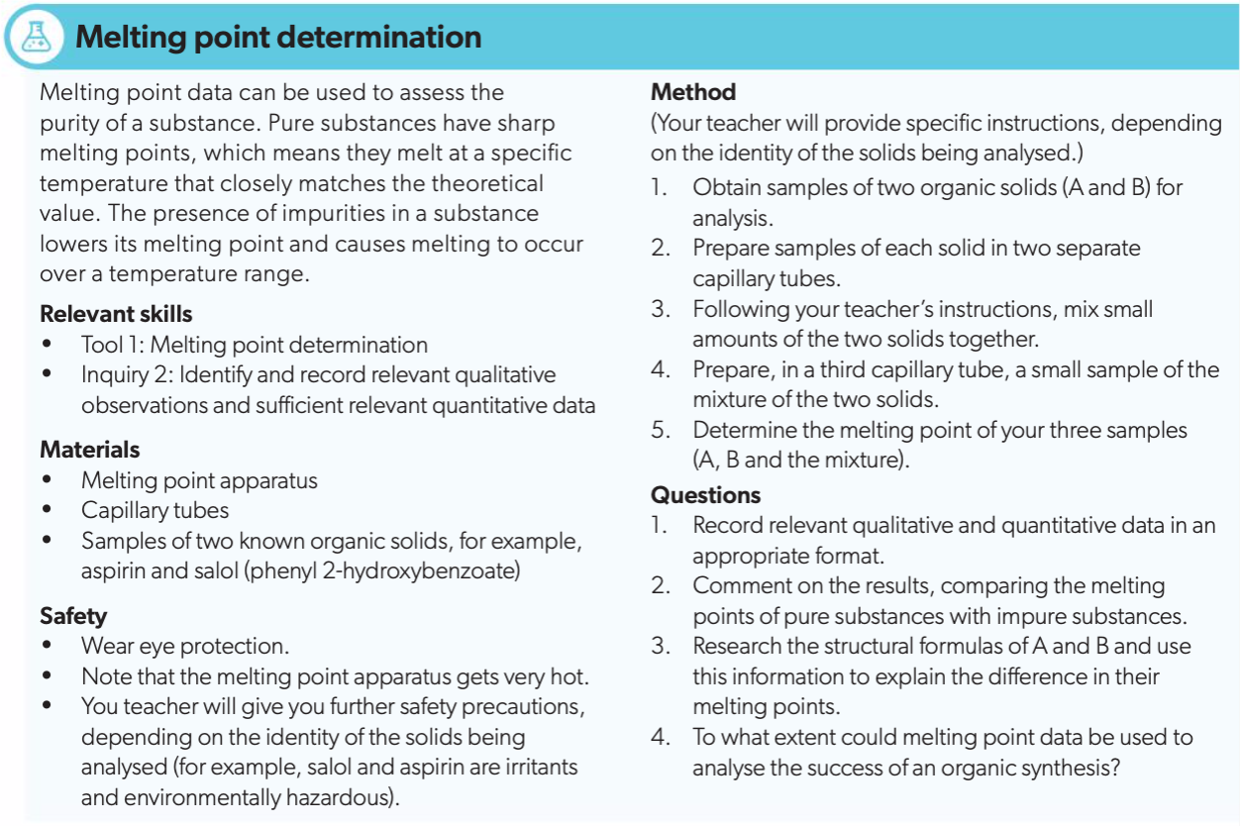

Slide 13
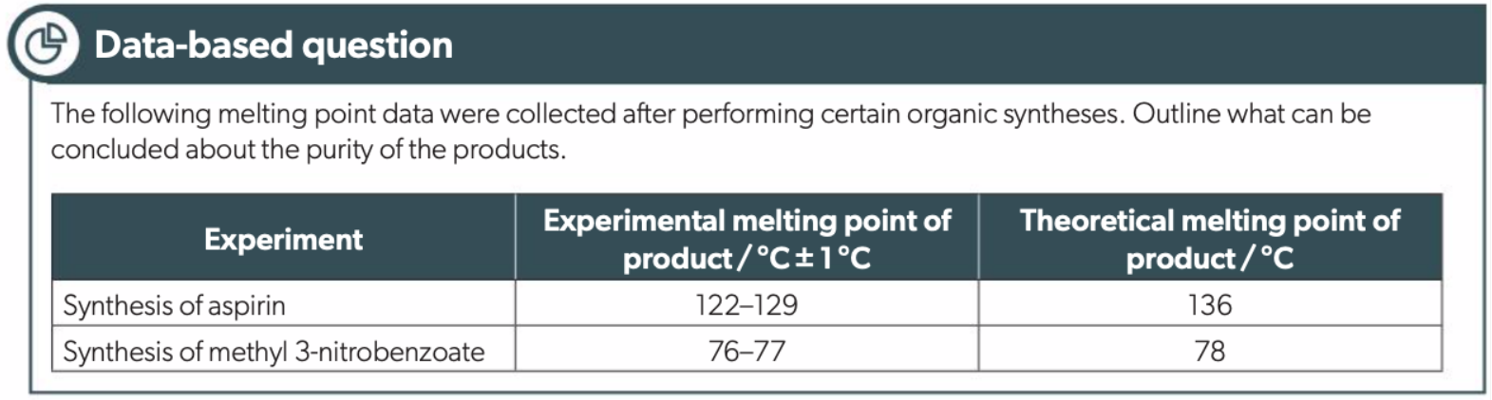

Slide 14
Separating different types of mixture
Suspension of solid in liquid | Filtration or centrifugation
Solution of solid in liquid | To obtain solid: use evaporation (crystallisation) To obtain liquid (or both): use distillation
Liquid + liquid (immiscible) | Use a separating funnel or decantation
Solid + solid (powdered mixture) | Use some difference in properties, e.g density, solubility, sublimation, magnetism
Two (or more) liquids mixed together (miscible) fractional distillation | Fractional distillation
Solution of two (or more) organic solids in a liquid | chromatography

Slide 15
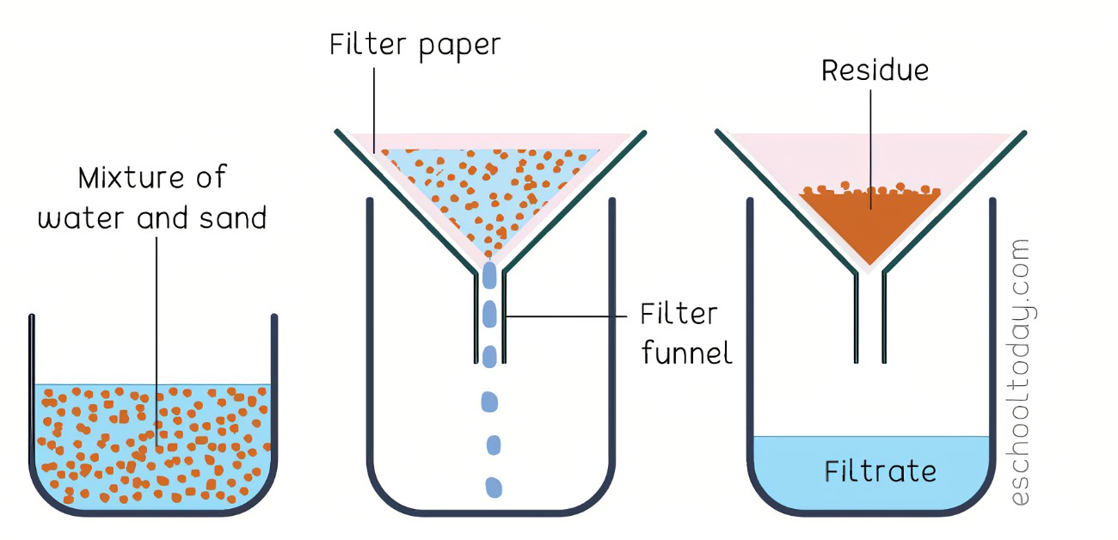
Filtration

Slide 16
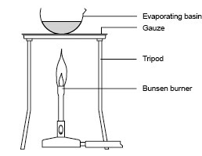
Evaporation

Slide 17
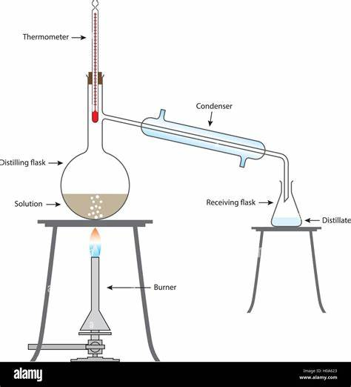
Distillation

Slide 18
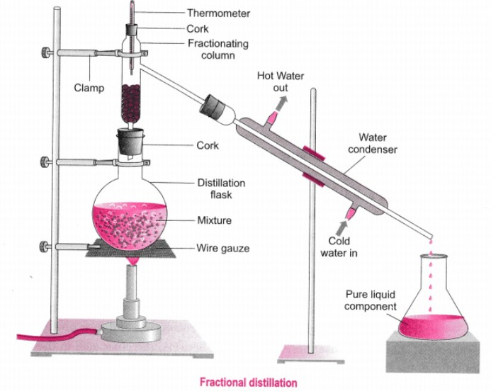
Fractional Distillation

Slide 19
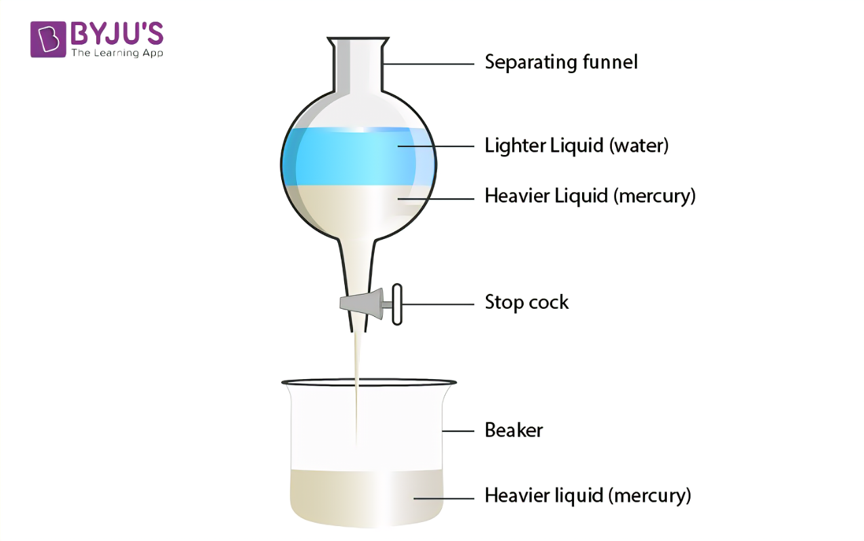
Decantation

Slide 20
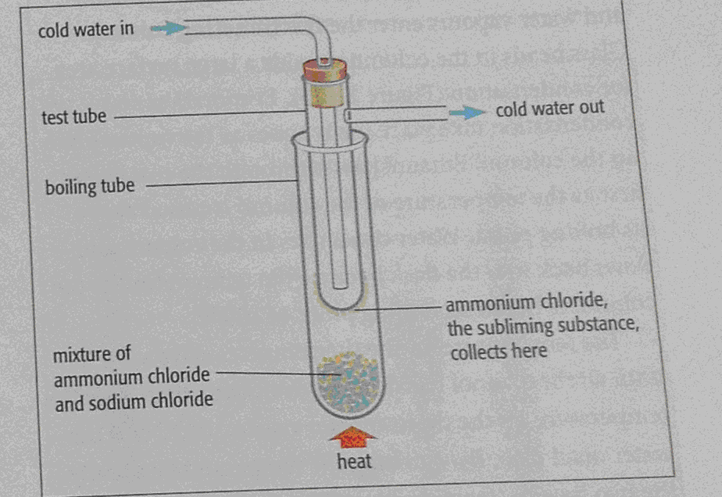
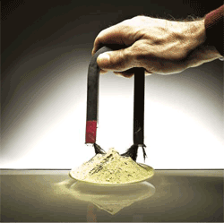

Slide 21
Chromatography

Slide 22
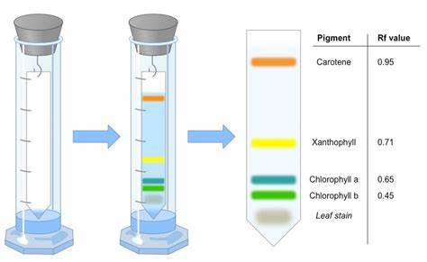

Slide 23
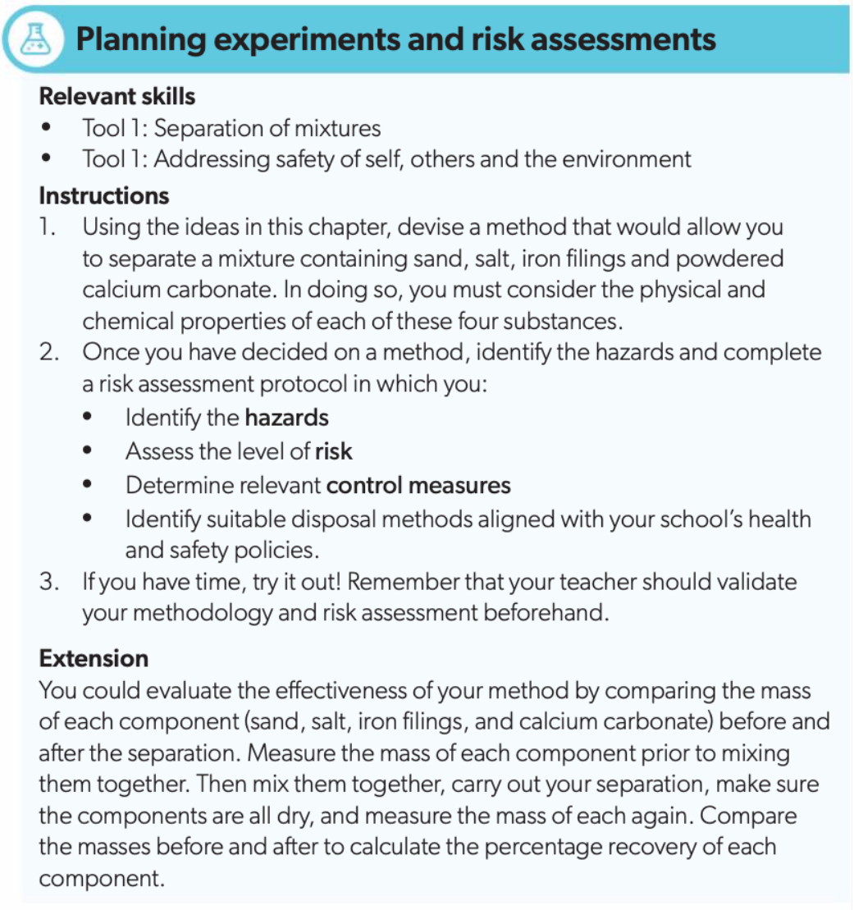

Slide 24
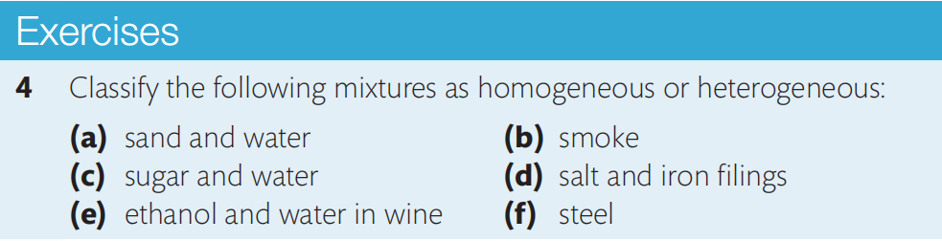
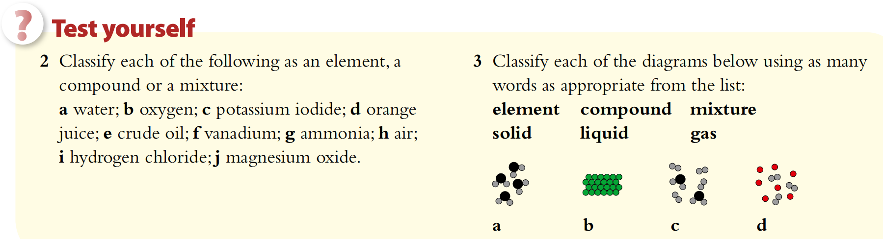

Slide 25
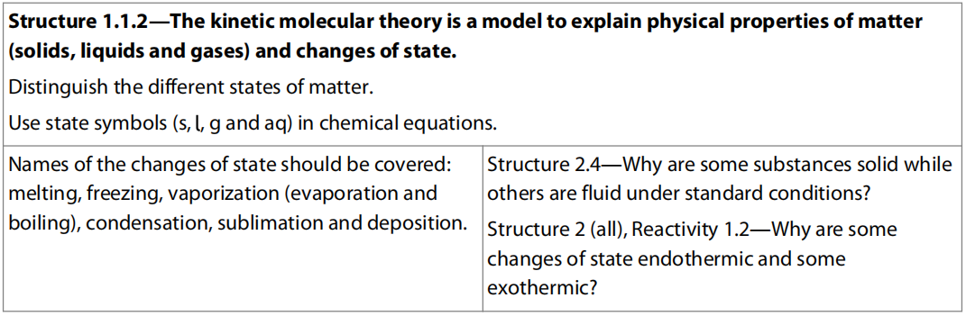
1.2 Physical States

Slide 26
States of Matter

Slide 27
Change of States

Slide 28
Vaporization
The process of changing liquid to gas including evaporation and boiling.
Evaporation occurs only at the surface and takes place at temperatures below the boiling point.
Boiling is a volume phenomenon, characterized by particles leaving throughout the body of the liquid – which is why bubbles occur, and occurs at a specific temperature (boiling point), determined by when the vapour pressure reaches the external pressure.

Slide 29
Vapor Pressure
Because of the process of evaporation, there is a certain amount of vapor of the liquid above this liquid in a closed container.
When reaches equilibrium, the gas pressure created by this liquid vapor is called vapor pressure.
It increases with the increasing temperature.
When it reaches a certain temperature that the vapor pressure equals the atmospheric pressure, then this temperature is called the boiling point.

Slide 31
State Symbols in Equations
State symbols are used to show the states of the reactants and products taking part in a reaction. These are abbreviations, which are given in brackets after each term in an equation, as shown below.

Slide 32
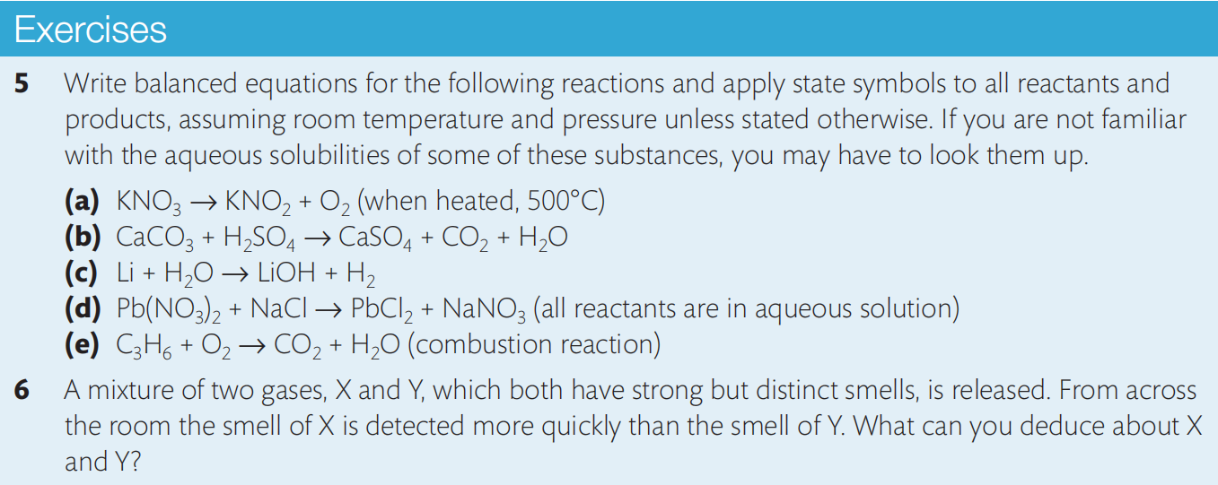

Slide 33
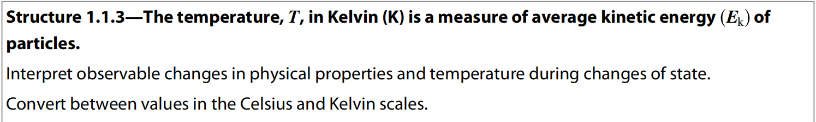
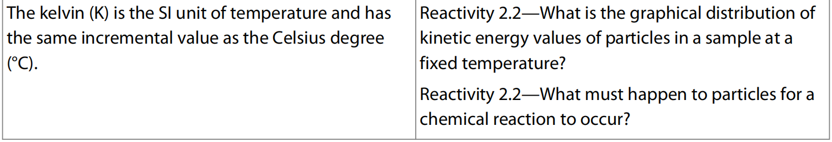
1.3 Kinetic Theory

Slide 34
Kinetic Theory
The average kinetic energy of the particles is directly related to the temperature of the system. The average kinetic energy is proportional to the temperature in Kelvin
The state of matter at a given temperature and pressure is determined by the strength of forces that may exist between the particles, known as inter-particle forces.

Slide 35
Kinetic energy (KE) refers to the energy associated with movement or motion. It is determined by the mass (m) and velocity or speed (v) of a substance, according to the relationship: KE= ½mv²
As the kinetic energy of the particles of substances at the same temperature is equal, this means there is an inverse relationship between mass and velocity. This is why substances with lower mass diffuse more quickly than those with greater mass, when measured at the same temperature.

Slide 36
Diffusion
Liquids and gases are referred to as fluids, which refers to their ability to flow. It means that they take the shape of their container.
Diffusion is the process by which the particles of a substance become evenly distributed, as a result of their random movements. Fluid properties are why diffusion occurs predominantly in gas and liquid states.

Slide 37
